Slide 1
PRODUCTS CHOOSEN FOR DESCRIPTION
The products choosen for the description are as follows:
1.Iphone 15pro max
2. Apple watch series 9
3. Airpods 3 generation

Slide 2
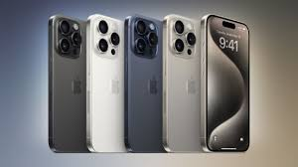
Iphone 15 Pro Max
The Iphone 15 pro max is made up of titanium metal which is so strong and so light
The A17 pro which is Game- changing chip gives Ground breaking performance.
The cameras given in Iphone has the feature of Next Gen portraits, longest optical zoom upto 5X
The Phone has been made with USB-C with USB 3 which boosts the transfers upto 20X
The action button acts as a fast track to your favourite feature.
The battery given in the phone is positively pro which stands upto 29 hours in video playback.
The Internal structural frame of iphone 15pro max has 100% recycled aluminium.

Slide 3
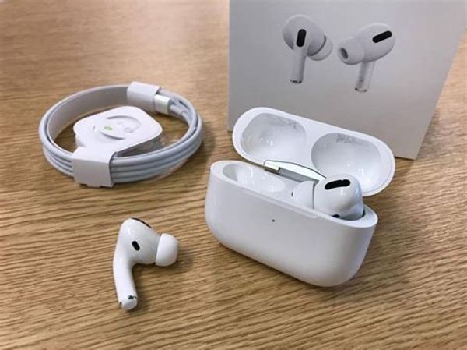
Airpods 3 generation
Iphone Head phones 3rd Genderation Wireless Bluetooth Ear buds with USB-C Fast charging Case, Running /Fitness (Touch Control, Sweat and Water Resistant)
100% up to 25+Hours of use

Slide 4
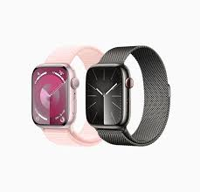
Apple watch series 9
The S9 chip enables a super bright display and a magical new way to quickly and easily interact with your Apple Watch without touching the screen. Advanced health, safety and activity feature provide powerful insights and help when you need it. And redesigned apps in watchOS give you more information at a glance.
CARBON NEUTRAL – An aluminium Apple Watch Series 9 paired with the latest Sport loop is carbon neutral,
ADVANCED HEALTH SPEC – keep an eye on your blood oxygen. Take an ECG anytime. Get notifications if you have an irregular heart rhythm. See how much time spent in REM, Core, or Deep sleep with sleep stages. Temperature sensing provides insights into overall well being and cycle tracking. And take note of your state of mind to help build emotional awareness and resilience.

Slide 5
Description of the platform on which the “apple.com” is build
The website of apple uses Google search appliances and atlassian cloud for CMS.

Slide 6
Website responsive design and Mobile Optimization
www.guvi.in has very good website responsive design and well optimized for mobile.
www.apple.com has very good website responsive design and well optimized for mobile.
www.tataconsultancyservices.com has very good website responsive design and well optimized for mobile.
www.panuval.com has very good website responsive design and well optimized for mobile.
www.audi.in has very good website responsive design and well optimized for mobile.

Slide 7
Common Website Design mistakes in www.apple.com are:
The header used in the website is too large and fixed.
The fonts used in this website is too thin and light.
The website landing page has too much of slide shows and video content which distracts the customer who came to know about a particular product. The previous and next arrows have low discoverability.
The website is missing with social media links
The option for more ways to shop in the website is not highlighted.

Slide 8
A list of best practices for creating visually appealing and user friendly website:
Simplicity- The website should be very simple to access and the customer should not feel it is complex to search the data required for them.
Visual Hierarchy – The most important and updated data’s should be arranged first to grab the attention of the visitors.
Responsivity – It is more important to provide a great experience across different devices to look identical across the devices.
Accessability - The goal of web accessibility is to make a website that anyone can use, including people with disabilities or limitations that affect their browsing experience.
User – Centricity – The usability and user experience should be highly preferable to end-users.

Slide 9
Landing Page Design for iphone15 Pro Max:
https://www.canva.com/design/DAF_ta6vCyE/CqESUMb8r0DlnEMBW1V5Ng/edit?utm_content=DAF_ta6vCyE&utm_campaign=designshare&utm_medium=link2&utm_source=sharebutton

